Slide 1
Konigsberg Bridges

Slide 2
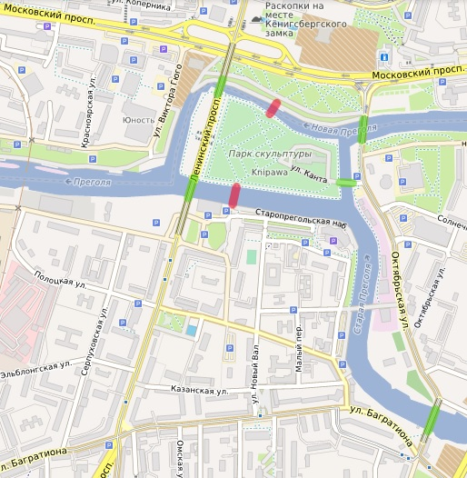
Kӧnigsberg Bridges Problem
The problem:
The map seen here shows Kӧnigsberg, where 7 bridges allow access between sections.
These 7 bridges are coloured in green and red.
This oval highlights a bridge on the map

Slide 3
Kӧnigsberg Bridges Problem
The problem:
Is there any way that we can walk across all 7 bridges without crossing any bridge twice?

Slide 4
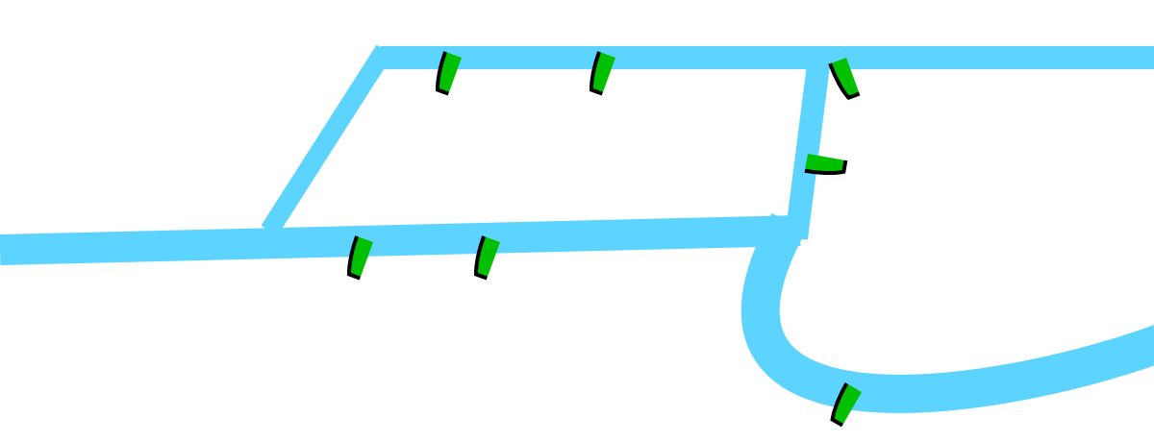
Kӧnigsberg Bridges Problem
There are still 2 bridges left, and no matter which one we choose, we will be stuck.
Simplifying the diagram
The streets and other information aren’t needed for this problem.
If we start at point A, can we walk across all 7 bridges without crossing any bridge twice?
A
Now we are stuck and will need to start again.

Slide 5
Kӧnigsberg Bridges Problem
What if you could start from anywhere?
Try it for yourself
Can you find a path that works?
C
B
D
A

Slide 6
Kӧnigsberg Bridges Problem
Possible Attempts

Slide 7
Kӧnigsberg Bridges Problem
Solutions
None of our examples worked. Is there a way to cross all 7 bridges without crossing any of them twice?
C
B
D
A
Notes:
There is no solution.

Slide 8
Kӧnigsberg Bridges Problem
Network
Would it be easier to investigate this if it were a network?
C
What would be the vertices?
What would be the edges?
B
D
A
Notes:
Vertices would be the different landareas, A, B, C and D
Edges would be the 7 bridges

Slide 9
Kӧnigsberg Bridges Problem
Network - Vertices
The vertices would be the different land spaces
C
B
D
A
Notes:
Vertices would be the different landareas, A, B, C and D
Edges would be the 7 bridges

Slide 10
Kӧnigsberg Bridges Problem
Network - Edges
The edges would be the 7 bridges
C
B
D
A
Notes:
Vertices would be the different landareas, A, B, C and D
Edges would be the 7 bridges

Slide 11
Kӧnigsberg Bridges Problem
Network - Edges
Now remove the picture to make it a little simpler to view.
C
B
D
A
Notes:
Vertices would be the different landareas, A, B, C and D
Edges would be the 7 bridges

Slide 12
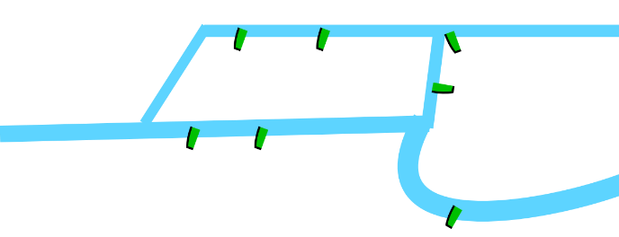
Kӧnigsberg Bridges Problem
Which image is the best to investigate with?
Simple Map
Network Diagram
Map
Notes:
Vertices would be the different landareas, A, B, C and D
Edges would be the 7 bridges

