Slide 1
Exploring patterns

Slide 2
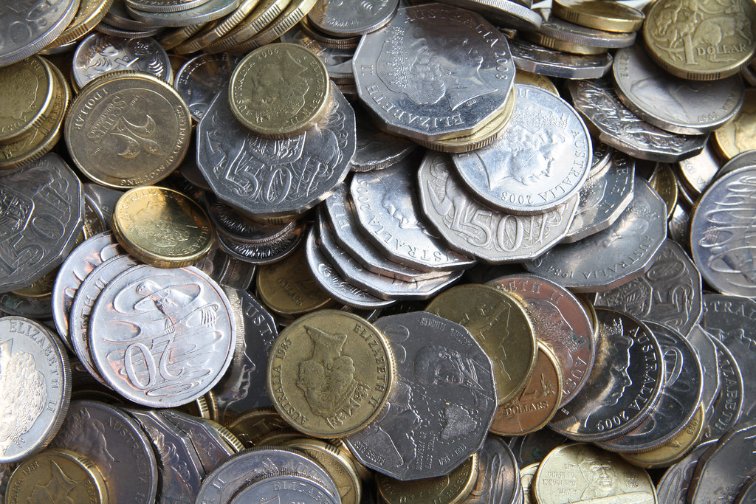
Grouping coins
What is one way to group coins?
Challenge: How many different ways can you group coins?

Slide 3
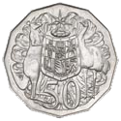
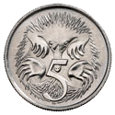
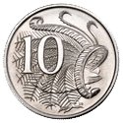
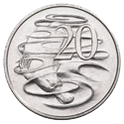
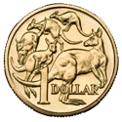
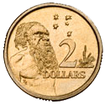
Grouping coins
Some examples:
Silver and gold
Value of the individual coin
Groups of coins that make up $1, $2, $5 or $10
Shape: curve edge or straight edges
Sides of the coin (front and back)

Slide 4
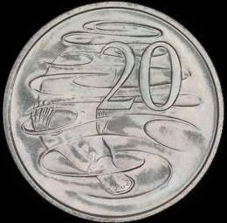
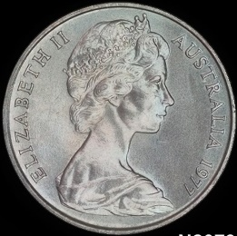
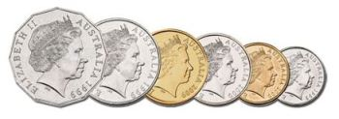
Creating patterns with coins
Some examples:

Slide 5
Creating patterns with coins
Predicting patterns
What do you think comes next in this pattern?
Are you sure?

Slide 6
Creating patterns with coins
Predicting patterns
Now what do you think will come next in this pattern?
Are you sure?

Slide 7
Creating patterns with coins
Predicting patterns
Did you get it right?
Can you predict the rest of the pattern?

Slide 8
Creating patterns with coins
Predicting patterns
What do you think comes next in this pattern?
Are you sure now?

Slide 9
Creating patterns with coins
Predicting patterns
What is being repeated in this pattern?

Slide 10
Creating patterns with coins
Predicting patterns
You can describe this pattern using letters.

Slide 11
Creating patterns with coins
Predicting patterns
A
B
A
B
A
B
?
What would come next?

Slide 12
Creating patterns with coins
Predicting patterns
Let’s try another pattern!
What do you think comes next in this pattern?

Slide 13
Creating patterns with coins
Predicting patterns
Now what do you think will come next in this pattern?
Are you sure?

Slide 14
Creating patterns with coins
Predicting patterns
What do you think comes next in the pattern now?
Did you predict a $2 coin?

Slide 15
Creating patterns with coins
Predicting patterns
Can you predict what comes next?
Are you sure now?

Slide 16
Creating patterns with coins
Predicting patterns
Are you starting to feel more confident in your predictions??
Another 10 cent coin!

Slide 17
Creating patterns with coins
Predicting patterns
What has been repeated?
What will the next 3 coins be?

Slide 18
Creating patterns with coins
Predicting patterns
You can describe this pattern using letters as well.

Slide 19
Creating patterns with coins
Predicting patterns
A
B
C
A
B
C
A
B
C
Wonder if we can use these types of patterns with other objects?

Slide 20
Creating patterns with coins
Predicting patterns
Let’s try another pattern!
What do you think comes next in this pattern?

Slide 21
Creating patterns with coins
Predicting patterns
Did you get it right?
What do you think comes next now?

Slide 22
Creating patterns with coins
Predicting patterns
What do you think comes next?
Are you sure?

Slide 23
Creating patterns with coins
Predicting patterns
Do you think the next coin will be a 5 cent coin, $1 coin or a different coin?
How sure are you?

Slide 24
Creating patterns with coins
Predicting patterns
Another 5 cent coin!
What comes next in this pattern?

Slide 25
Creating patterns with coins
Predicting patterns
Do you think the next coin will be a $1 coin or something different?
Are you sure?

Slide 26
Creating patterns with coins
Predicting patterns
?
Let’s try another pattern!
What do you think comes next in this pattern?

Slide 27
Creating patterns with coins
Predicting patterns
You guessed it!

Slide 28
Creating patterns with coins
Predicting patterns
A
A
B
B
A
A
B
B
This is what this pattern looks like with letters

Slide 29
Enrichment task
Creating patterns
Draw patterns using other shapes, colours or objects that follow the same patterns seen in this PowerPoint.
For example you could draw an ABABABAB pattern using types of cars:
or you could create an ABCABCABC pattern using chocolate M&M’s or smarties:

